Slide 1
ADVANCED OOP WITH JAVA
Instructor:

Slide 2
Table of contents
Polymorphism
Types of Polymorphism
Method Overloadding
Method Overriding
Static and Dynamic binding
Abstraction
Abstract class
Interfaces

Slide 3
Learning Approach
Strongly suggested for a better learning and understanding of this course:
Noting down the key concepts in the class
Analyze all the examples / code snippets provided
Study and understand the self study topics
Completion and submission of all the assignments, on time
Completion of the self review questions in the lab guide
Study and understand all the artifacts
Completion of the project on time inclusive of individual and group activities
Notes:
The following are strongly suggested for a better learning and understanding of this course:
Noting down the key concepts in the class
Analyze all the examples / code snippets provided
Study and understand the self study topics
Completion and submission of all the assignments, on time
Completion of the self review questions in the lab guide
Study and understand all the artifacts including the reference materials / e-learning / supplementary materials specified
Completion of the project (if application for this course) on time inclusive of individual and group activities
Taking part in the self assessment activities
Participation in the doubt clearing Sections

Slide 4
polymorphism
Section 1

Slide 5
4 major principles of OOP
Inheritance
Encapsulation
Polymorphism
Abstraction

Slide 6
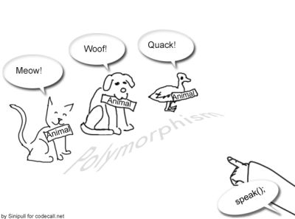
Polymorphism Overview (1/2)
In object-oriented programming, polymorphism (from the Greek (Hy Lạp) meaning "having multiple forms").
Polymorphism is derived from 2 greek words: poly and morphs.
The word "poly" means many and "morphs" means forms.
There are two types of polymorphism in java:
compile time polymorphism: method overloading.
runtime polymorphism: method overriding.
one name, many forms.

Slide 7
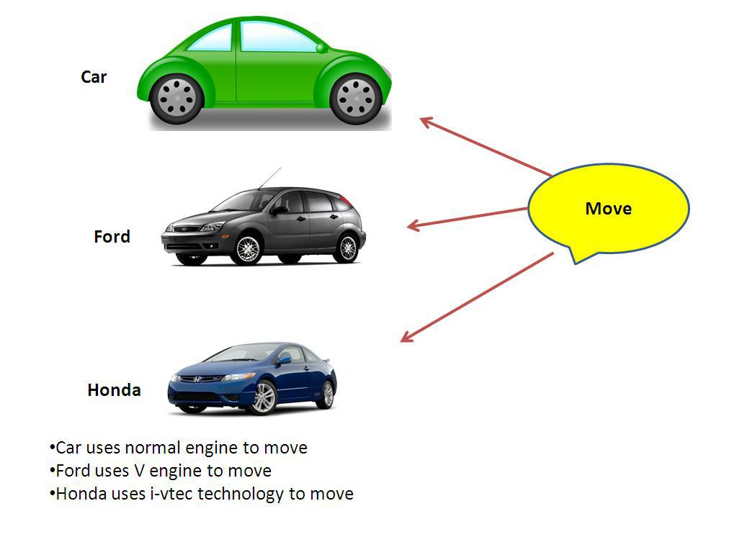
Polymorphism Overview (2/2)
You can use the same name for several different things
the compiler automatically figures out which version you wanted.
There are several forms of polymorphism supported in Java, shadowing, overriding, and overloading.
Polymorphism is a generic term for having many forms.
Notes:
automatically figures out: tự động hiểu ra
Polymorphism is a generic term for having many forms. You can use the same name for several different things and the compiler automatically figures out which version you wanted. There are several forms of polymorphism supported in Java, shadowing, overriding, and overloading

Slide 8
Polymorphism example
<<Abstract>>
Shap
- String Color
Shap(Color)
+ String getColor()
+ void setColor()
+ abstract String draw()
Circle
Rectangle

Slide 9
Polymorphism example (1/4)
public abstract class Shape {
private String color;
public Shape(String color) {
this.setColor(color);
}
public String getColor() {
return Color;
}
public void setColor(String color) {
Color = color;
}
// abstract method
abstract public String draw();
}

Slide 10
Polymorphism example (2/4)
public class Circle extends Shape {
/**
* @param color
*/
public Circle(String color) {
super(color);
}
@Override
public String draw() {
return "I'm a " + this.getColor() + " circle.";
}
}

Slide 11
Polymorphism example (3/4)
public class Rectangle extends Shape {
/**
* @param color
*/
public Rectangle(String color) {
super(color);
}
@Override
public String draw() {
return "I'm a " + this.getColor() + " rectangle.";
}
}

Slide 12
Polymorphism example (4/4)
public class PolymorphismExample {
private List<Shape> shapes = new ArrayList<Shape>();
public PolymorphismExample() {
Shape myFirstCircle = new Circle("Red");
Circle mySecondCircle = new Circle("Blue");
Rectangle myFirstRectangle = new Rectangle("Green");
shapes.add(myFirstCircle);
shapes.add(mySecondCircle);
shapes.add(myFirstRectangle);
}
public List<Shape> getShapes() {
return shapes;
}
public static void main(String[] args) {
PolymorphismExample example = new PolymorphismExample();
for (Shape shape : example.getShapes()) {
System.out.println(shape.draw());
}
}
}
Output:
I'm a Red circle.
I'm a Blue circle.
I'm a Green rectangle.
Notes:
Remember, we declare myFirstCircle as a Shape and point to a Circle instance, then when draw, it should drawing as a Circle

Slide 13
Types of Polymorphism
There are two types of polymorphism in java:
Static Polymorphism also known as compile time polymorphism
Dynamic Polymorphism also known as runtime polymorphism
Compile time Polymorphism (or Static polymorphism)
Polymorphism that is resolved during compiler time is known as static polymorphism. Method overloading is an example of compile time polymorphism.
Method Overloading: This allows us to have more than one method having the same name, if the parameters of methods are different in number, sequence and data types of parameters.

Slide 14
Method Overloading
Overloaded methods let you reuse the same method name in a class, but with different arguments (and optionally, a different return type).
There are two ways to overload the method in java:
By changing number of arguments
By changing the data type
In a subclass,
you can overload the methods inherited from the superclass.
such overloaded methods neither hide nor override the superclass methods
they are new methods, unique to the subclass.

Slide 15
Method Overloading
Some main rules for overloading a method:
Overloaded methods must change the argument list.
Overloaded methods can change the return type.
Overloaded methods can change the access modifier.
With override: Cannot reduce the visibility
A method can be overloaded in the same class or in a subclass.
Note: When I say method signature I am not talking about return type of the method, for example if two methods have same name, same parameters and have different return type, then this is not a valid method overloading example. This will throw compilation error.

Slide 16
Types of Polymorphism
public class SimpleCalculator {
int add(int number1, int number2) {
return number1 + number2;
}
int add(int number1, int number2, int number3) {
return number1 + number2 + number3;
}
double add(double number1, double number2) {
return number1 + number2;
}
}
public class TestSimpleCalculator {
public static void main(String[] args) {
SimpleCalculator simpleCalculator = new SimpleCalculator();
System.out.println(simpleCalculator.add(10, 20));
System.out.println(simpleCalculator.add(10, 20, 30));
System.out.println(simpleCalculator.add(12.5, 20.5));
}
}

Slide 17
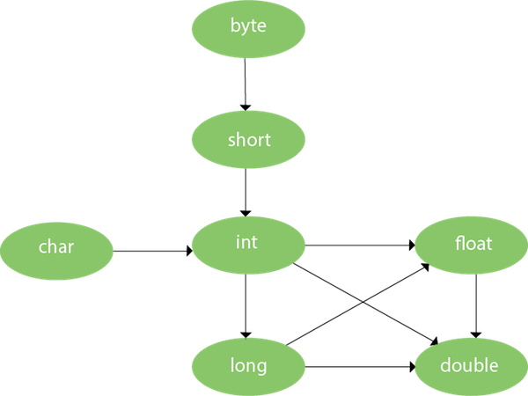
Method Overloading and Type Promotion
One type is promoted to another implicitly if no matching datatype is found:

Slide 18

Practice time
A program calculates and displays bonus amounts to pay various types of employees. There are 3 separate departments, numbered 1, 2, and 3.
Department 1 employees are paid a bonus based on their sales: If their sales amount is over $5000 they get 5% of those sales, otherwise they get nothing.
Department 2 employees are paid a bonus based on the number of units they sell: They get $100 per unit sold, and an extra $50 per unit if they sell more than 25 units; if they sell no units, they get nothing.
Department 3 employees assemble parts in the plant and are paid a bonus of 10 cents per part if they reach a certain level: Part-time employees must assemble more than 250 parts to get the 10-cent-per-part bonus, and full-time employees must assemble more than 700.
Write a set of 3 overloaded methods called getBonus() that works with the program below, according to the specifications described above.

Slide 19
Method Overriding
Declaring a method in subclass which is already present in parent class is known as method overriding.
The main advantage of method overriding is:
the class can give its own specific implementation to a inherited method without even modifying the parent class(base class).
Rules of method overriding in Java:
Method name: method must have the same name as in the parent class.
Argument list: must be same as that of the method in parent class,
Access Modifier: cannot be more restrictive than the overridden method of parent class.

Slide 20
Overriding Examples
class Mammal {
String makeNoise() {
return "generic noise";
}
}
class Zebra extends Mammal {
String makeNoise() {
return "bray";
}
}
public class ZooKeeper {
public static void main(String[] args) {
Mammal m = new Zebra();
System.out.println(m.makeNoise());
}
}

Slide 21
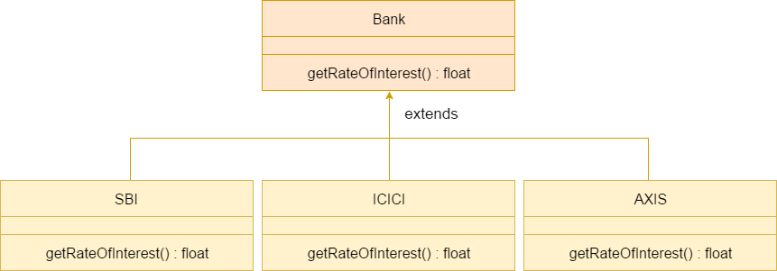
A real example of Method Overriding
Consider a scenario where Bank is a class that provides functionality to get the rate of interest. However, the rate of interest varies according to banks.
For example, SBI, ICICI and AXIS banks could provide 8%, 7%, and 9% rate of interest.

Slide 22
Shadowing
This is called shadowing—name in class Dog shadows name in class Animal
public class Animal {
String name = "Animal";
public void speak() {
System.out.println("generic speak!");
}
public static void main(String args[]) {
Animal animal1 = new Animal();
Animal animal2 = new Dog();
Dog dog = new Dog();
System.out.println(animal1.name + " " + animal2.name +" " + dog.name);
}
}
class Dog extends Animal {
String name = "Dog";
public void speak() {
System.out.println("dog speak!");
}
}
Animal Animal Dog

Slide 23
Static and Dynamic binding
Static binding:
The binding which can be resolved at compile time by compiler is known as static or early binding.
The binding of static, private and final methods is compile-time. The reason is that the these method cannot be overridden and the type of the class is determined at the compile time.
Dynamic binding:
When compiler is not able to resolve the call/binding at compile time, such binding is known as Dynamic or late Binding.
Method Overriding is a perfect example of dynamic binding as in overriding both parent and child classes have same method and in this case the type of the object determines which method is to be executed.
The type of object is determined at the run time so this is known as dynamic binding.

Slide 24
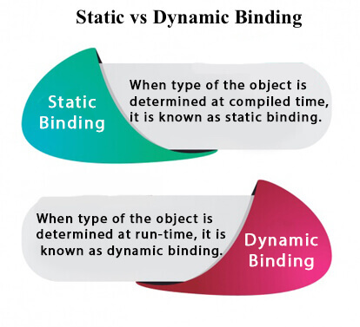
Static and Dynamic binding
Static binding | Dynamic binding
Happens at Compile time | Happens at Runtime
Actual object is not used | Actual object is used
Also known as Early binding | Also known as Late binding
Speed is high | Speed is low
Ex: - Method Overloading | Ex: - Method Overriding

Slide 25
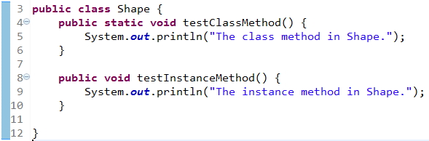
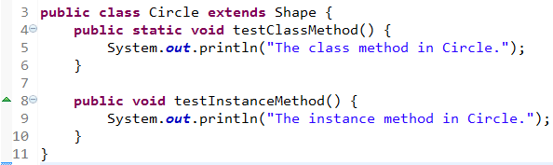
Static binding (Hiding method)
If a subclass defines a class method with the same signature as a class method in the superclass, the method in the subclass hides the one in the superclass.
Notes:
The first is Shape, which contains one instance method and one class method.
The second class, a subclass of Shape, is called Circle. The Circle class overrides the instance method in Shape and hides the class method in Shape.

Slide 26
Static binding (Hiding method)
public class TestOverridingAndHiding {
public static void main(String[] args) {
Circle myCircle = new Circle();
Shape myShape = myCircle;
Shape.testClassMethod();
myShape.testInstanceMethod();
}
}
Output:
The class method in Shape.
The instance method in Circle.
Notes:
As promised, the version of the hidden method that gets invoked is the one in the superclass, and the version of the overridden method that gets invoked is the one in the subclass.

Slide 27
Static binding
public class Boy extends Human {
public static void walk() {
System.out.println("Boy walks");
}
public static void main(String args[]) {
/* Reference is of Human type and object is
* Boy type
*/
Human obj = new Boy();
/* Reference is of HUman type and object is
* of Human type.
*/
Human obj2 = new Human();
obj.walk();
obj2.walk();
}
}
class Human {
public static void walk() {
System.out.println("Human walks");
}
}
Output:
Human walks
Human walks

Slide 28
Dynamic binding
public class Boy extends Human {
public void walk() {
System.out.println("Boy walks");
}
public static void main(String args[]) {
/* Reference is of Human type and object is
* Boy type
*/
Human obj = new Boy();
/* Reference is of HUman type and object is
* of Human type.
*/
Human obj2 = new Human();
obj.walk();
obj2.walk();
}
}
class Human {
public void walk() {
System.out.println("Human walks");
}
}
Output:
Boy walks
Human walks

Slide 29
Covariant Return Type
The covariant return type specifies that the return type may vary in the same direction as the subclass.
Before Java5, it was not possible to override any method by changing the return type.
But now, since Java5, it is possible to override method by changing the return type if subclass overrides any method whose return type is Non-Primitive but it changes its return type to subclass type.
Example:
class A{
A get(){return this;}
}
class B extends A{
B get(a){return this;}
void message(){System.out.println("welcome to covariant return type");
}
public static void main(String args[]){
new B().get().message();
}
}

Slide 30
instanceof operator
The java instanceof operator is used to test whether the object is an instance of the specified type (class or subclass or interface).
The instanceof is also known as type comparison operator because it compares the instance with type.
It returns either true or false.
If we apply the instanceof operator with any variable that has null value, it returns false.
Example:
class Animal{}
class Dog extends Animal{//Dog inherits Animal
public static void main(String args[]){
Animal a = new Animal();
Dog d = new Dog();
System.out.println(a instanceof Animal);//true
System.out.println(d instanceof Animal);//?
}
}
Output:
true
true

Slide 31
instanceof operator Downcasting
When Subclass type refers to the object of Parent class, it is known as downcasting.
Let's see the example, downcasting be performed without the use of instanceof operator:
The actual object that is referred by a, is an object of Dog class. So if we downcast it, it is fine.
class Animal {
}
public class Dog extends Animal {
static void cast(Animal a) {
Dog d = (Dog) a;
System.out.println("Downcasting performed");
}
public static void main(String[] args) {
Animal animal = new Dog();
cast(animal);
}
}

Slide 32
instanceof operator
But what will happen if we write:
You faced with an exception:
To resolve this problem, should perform downcasting with java instanceof operator. Re-write code:
Animal animal = new Animal();
Dog d = cast(animal);
Exception in thread "main" java.lang.ClassCastException: fa.training.jpe.Animal cannot be cast to fa.training.jpe.Dog
class Animal {}
public class Dog extends Animal {
static void cast(Animal a) {
if (a instanceof Dog) {
Dog d = (Dog) a;
System.out.println("Downcasting performed");
}
}
public static void main(String[] args) {
Animal animal = new Animal();
cast(animal);
}
}

Slide 33
ABSTRACTION
Section 2

Slide 34
4 major principles of OOP
Inheritance
Encapsulation
Polymorphism
Abstraction

Slide 35
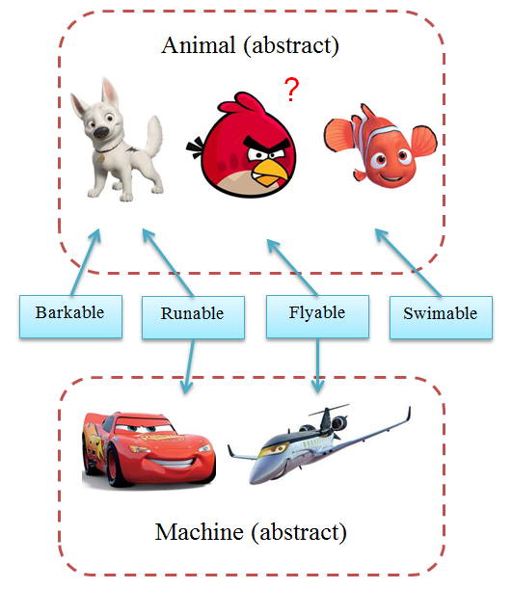
Abstraction Overview
Abstraction is a process of hiding the implementation details and showing only functionality to the user.
Example:
Sending sms, you just type the text and send the message. You don't know the internal processing about the message delivery
It shows only important things to the user and hides the internal details
Focus on what the object does instead of how it does it.
There are two ways to achieve abstraction in java:
Abstract class (0 to 100%)
Interface (100%)
Notes:
Another way, it shows only important things to the user and hides the internal details
Example sending sms, you just type the text and send the message. You don't know the internal processing about the message delivery.
Abstraction lets you focus on what the object does instead of how it does it.
There are two ways to achieve abstraction in java:
Abstract class (0 to 100%)
Interface (100%)

Slide 36
Purposes of Abstraction
Abstraction is used to manage complexity.
For example: "sending SMS where you type the text and send the message, you don't know the internal processing about the message delivery".
Abstraction lets you focus on what the object does instead of how it does it.
There are two ways to achieve abstraction in java
Abstract class (0 to 100%)
Interface (100%)

Slide 37
Purposes of Abstraction
Abstraction is used to manage complexity.
All Square, Rectangle, Circle and Triangle:
Have color
Can display
A shape may has all above characteristics:
So we call “Shape” is an abstract type of Square, Rectangle, Circle and Triangle.
Shape
More abstract
Square
Rectangle
Circle
Triangle
More specific

Slide 38
Go abstraction
Then, we analysis deeper:
A rectangle has four sides with lengths w and h
A square has all of the characteristics of a rectangle; in addition, w = h
So, square is a type of rectangle, or, rectangle can be an abstract type of square
More abstract
Shape
Rectangle
Square
Circle
Triangle
More specific

Slide 39
Abstract Class
A class which is declared as abstract is known as an abstract class.
It can have abstract and non-abstract methods.
It needs to be extended and its method implemented.
It cannot be instantiated.
Rules for Java Abstract class:
It can have abstract and non-abstract methods.
It cannot be instantiated.
It can have constructors and static methods also.
It can have final methods which will force the subclass not to change the body of the method.
1
An abstract class must be declared with an abstract keyword.
2
3
4
5

Slide 40
Abstract Class and Abstract method
An abstract class can not be instantiated (you are not allowed to create object of Abstract class), but they can be subclassed.
Shape shape = new Circle();
When an abstract class is subclassed, the subclass usually provides implementations for all of the abstract methods in its parent class.
However, if it does not, the subclass must also be declared abstract.
Abstract method:
An abstract method is a method that is declared without an implementation.
Example: abstract void moveTo(int x, int y);
If a class includes abstract methods, the class itself must be declared abstract.
All of the methods in an interface are implicitly abstract: so the abstract modifier is not used with interface methods.

Slide 41
Interface
An interface in Java is a blueprint of a class. It has static constants and abstract methods.
The interface in Java is a mechanism to achieve abstraction.
There can be only abstract methods in the Java interface, not method body.
It is used to achieve abstraction and multiple inheritance in Java.
Why use Java interface?
By interface, we can support the functionality of multiple inheritance.
It can be used to achieve loose coupling.
1
It is used to achieve abstraction.
2
3
Notes:
Since Java 8, we can have default and static methods in an interface.
Since Java 9, we can have private methods in an interface.

Slide 42
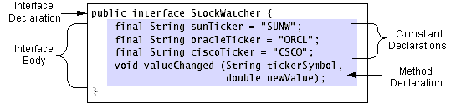
Interface
Syntax:
[public] interface <InterfaceName>[extends SuperInterface] {
// Interface Body
}
Example:
Notes:
Note:
phần thân khai báo các các hằng, các phương thức rỗng( không có cài đặt ), các phương thức này phải kết thúc với dấu chấm phẩy ‘;’, bởi vì chúng không có phần cài đặt.
Tất cả các thành phần của một giao diện tự động là public do vậy ta không cần phải cho bổ từ này vào và nếu ta thêm các bổ từ khác như private, protected trước các khai báo thì ta sẽ nhận được một lỗi lúc dịch.
Tất cả các trường tự động là final và static, nên ta không cần phải cho bổ từ này vào.

Slide 43
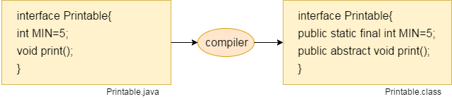
Interface
The Java compiler adds public and abstract keywords before the interface method.
Moreover, it adds public, static and final keywords before data members.
Consider the following figure:

Slide 44
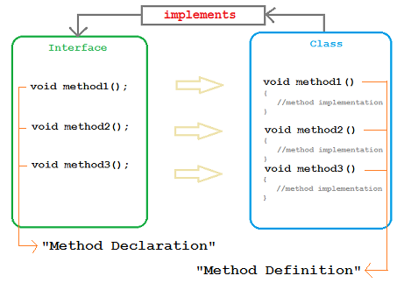
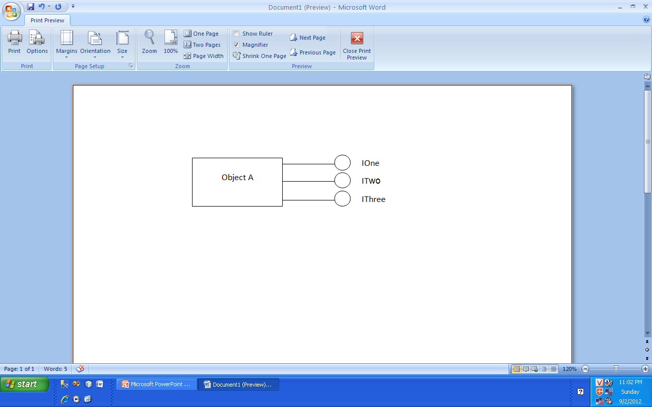
Interfaces
An interface is a definition of method prototypes and possibly some constants (static final fields).
An interface does not include the implementation of any methods.
A class can implement an interface, this means that it provides implementations for all the methods in the interface.
Java classes can implement any number of interfaces (multiple interface inheritance).

Slide 45
Java Interface Example: Bank
Let's see another example of java interface which provides the implementation of Bank interface.
interface Bank {
float rateOfInterest();
}
class SBI implements Bank {
public float rateOfInterest() {
return 9.15f;
}
}
class PNB implements Bank {
public float rateOfInterest() {
return 9.7f;
}
}
public class TestInterface {
public static void main(String[] args) {
Bank b = new SBI();
System.out.println("ROI: " + b.rateOfInterest());
}
}
Output:
ROI: 9.15

Slide 46
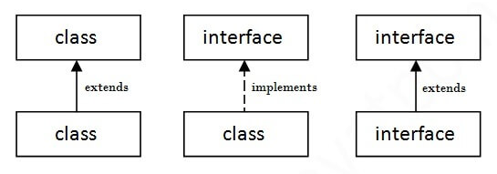
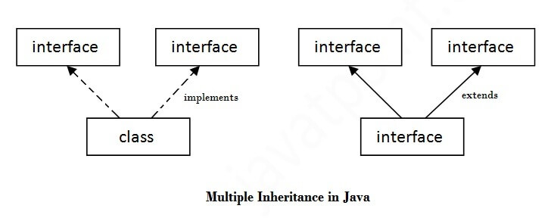
Classes and interfaces
As shown in the figure given below, a class extends another class, an interface extends another interface, but a class implements an interface.
Multiple inheritance in Java by interface

Slide 47
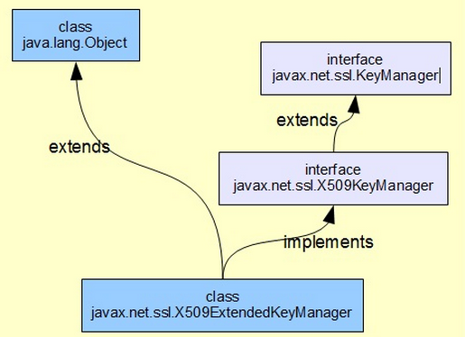
Interfaces can be extended
Example:
public interface Forward {
void drive();
}
public interface Stop {
void park();
}
public interface Speed {
void turbo();
}
public class GearBox {
public void move() {
}
one interface can extend another.

Slide 48
Interfaces can be extended (cont.)
Example:
class Automatic extends GearBox implements Forward, Stop, Speed
{
public void drive() {
System.out.println("drive()");
}
public void park() {
System.out.println("park()");
}
public void turbo() {
System.out.println("turbo()");
}
public void move() {
System.out.println("move()");
}
}

Slide 49
Interfaces can be extended (cont.)
Example:
public class Car {
public static void cruise(Forward x) {
x.drive();
}
public static void park(Stop x) {
x.park();
}
public static void race(Speed x) {
x.turbo();
}
public static void move(GearBox x) {
x.move();
}
public static void main(String[] args) {
Automatic auto = new Automatic();
cruise(auto); // Interface Forward
park(auto); // Interface Stop
race(auto); // Interface Speed
move(auto); // class GearBox
}
}

Slide 50
Multiple inheritance in Java by interface
Multiple inheritance is not supported in the case of class because of ambiguity.
However, it is supported in case of an interface because there is no ambiguity.
It is because its implementation is provided by the implementation class.
Example:
interface Printable {
void print();
}
interface Showable {
void print();
}
class A4 implements Printable, Showable {
public void print() {
System.out.println("Printing and showing document");
}
}
public class TestInterface2 {
public static void main(String[] args) {
A4 a4 = new A4();
a4.print();
}
}

Slide 51
Java 8 Static Method in Interface
Since Java 8, we can have method body in interface. But we need to make it default method.
Example:
interface Drawable {
void draw();
default void msg() {
System.out.println("default method");
}
}
class Rectangle implements Drawable {
public void draw() {
System.out.println("drawing rectangle");
}
}
public class TestInterfaceDefault {
public static void main(String[] args) {
Drawable d = new Rectangle();
d.draw();
d.msg();
}
}
Output:
drawing rectangle
default method
Notes:
Note:
phần thân khai báo các các hằng, các phương thức rỗng( không có cài đặt ), các phương thức này phải kết thúc với dấu chấm phẩy ‘;’, bởi vì chúng không có phần cài đặt.
Tất cả các thành phần của một giao diện tự động là public do vậy ta không cần phải cho bổ từ này vào và nếu ta thêm các bổ từ khác như private, protected trước các khai báo thì ta sẽ nhận được một lỗi lúc dịch.
Tất cả các trường tự động là final và static, nên ta không cần phải cho bổ từ này vào.

Slide 52
Java 8 Static Method in Interface
Since Java 8, we can have static method in interface.
Example:
interface Drawable {
void draw();
static int cube(int x) {
return x * x * x;
}
}
class Rectangle implements Drawable {
public void draw() {
System.out.println("drawing rectangle");
}
}
public class TestInterfaceStatic {
public static void main(String[] args) {
Drawable d = new Rectangle();
d.draw(); System.out.println(Drawable.cube(3));
}
}
Output:
drawing rectangle
27

Slide 53
Abstract class and Interface
Abstract class and interface both are used to achieve abstraction where we can declare the abstract methods. Abstract class and interface both can't be instantiated.
But there are many differences between abstract class and interface that are given below.
No. | Abstract class | Interface
1 | Abstract class can have abstract and non-abstract methods. | Interface can have only abstract methods.
2 | Abstract class doesn't support multiple inheritance. | Interface supports multiple inheritance.
3 | Abstract class can have final, non-final, static and non-static variables. | Interface has only static and final variables.
4 | Abstract class can have static methods, main method and constructor. | Interface can't have static methods, main method or constructor.
5 | Abstract class can provide the implementation of interface. | Interface can't provide the implementation of abstract class.
6 | The abstract keyword is used to declare abstract class. | The interface keyword is used to declare interface.
7 | Example: public abstract class Shape{ public abstract void draw(); } | Example: public interface Drawable{ void draw(); }

Slide 54
Summary
Polymorphism, which means "many forms,"
is the ability to treat an object of any subclass of a base class as if it were an object of the base class.
Abstract class is a class that may contain abstract methods and implemented methods.
An abstract method is one without a body that is declared with the reserved word abstract
An interface is a collection of constants and method declarations.
When a class implements an interface, it must declare and provide a method body for each method in the interface

Slide 55

Thank you
55

